Slide 1
Pre-processing
Adwait

Slide 2
About Linear Regression
Relationship between variables
Linear relationship is natural first assumption, unless theory rejects it.
Is it plausible that this is an exact, “deterministic” relationship?
Does line always fit data perfectly?
What causes this error?
What difficulties you see in applying regression model?

Slide 3
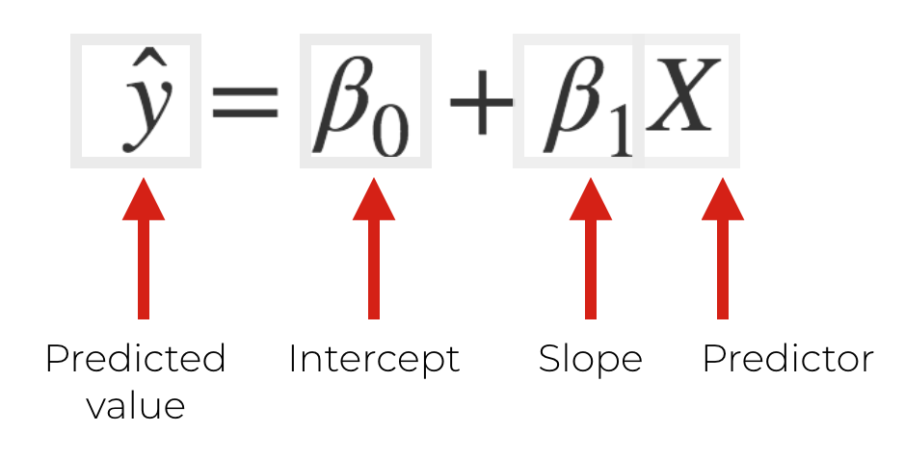
Linear Model
Linear assumption, Flexible, simple
Easy to interpret, generalize to multiple variables.
Notes:
Ref : https://www.sharpsightlabs.com/blog/linear-regression-in-r/

Slide 4
When things are not perfect.
Measurement error (incorrect definition or mismeasurement)
Other variables that affect y.
Relationship is not purely linear
Relationship may be different for different observations
Categorical Variables
Missing values
Outliers
Correlations
Constant Features

Slide 5
Handling Categorical variables
Nominal and Ordinal
Label Encoding - Assign a unique number to each possible outcome of the variable and replace the variables values
One Hot Encoding - categorical variable is converted into a binary vector.

Slide 6
Outlier Analysis I
Outlier is an observation that appears far away and diverges from an overall pattern in a sample.
Artificial and Natural
Outlier Analysis and treatment
Univariate – Box Plot, Standard Deviation, Interquartile Range
Bivariate - scatterplot with confidence ellipse
Multivariate – distance calculation in n dimensions

Slide 7
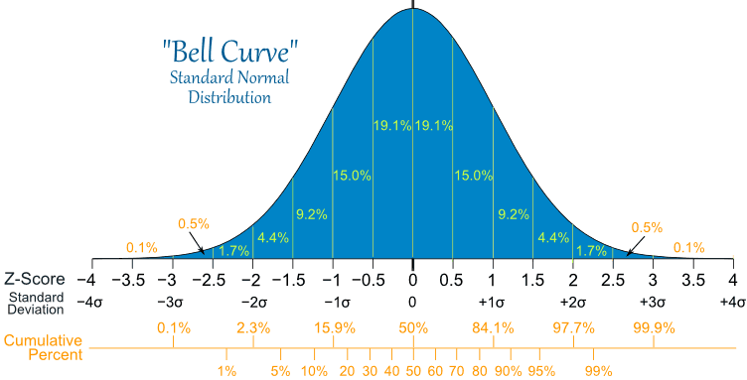
Normal Distribution
Notes:
Image Credit : https://spauldinggrp.com/calculating-standard-deviation-using-the-stats-worksheet-hp-12c/normal-distrubution-large/

Slide 8
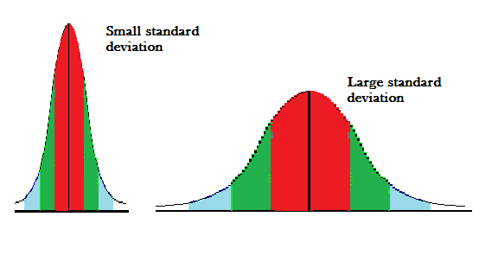
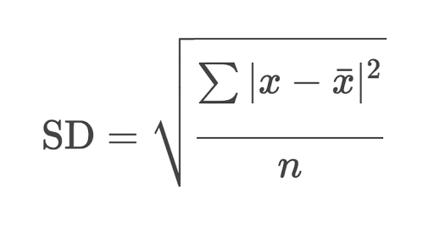
Standard Deviation
a quantity expressing by how much the members of a group differ from the mean value for the group.
Notes:
Ref : https://www.statisticshowto.datasciencecentral.com/probability-and-statistics/standard-deviation/

Slide 9
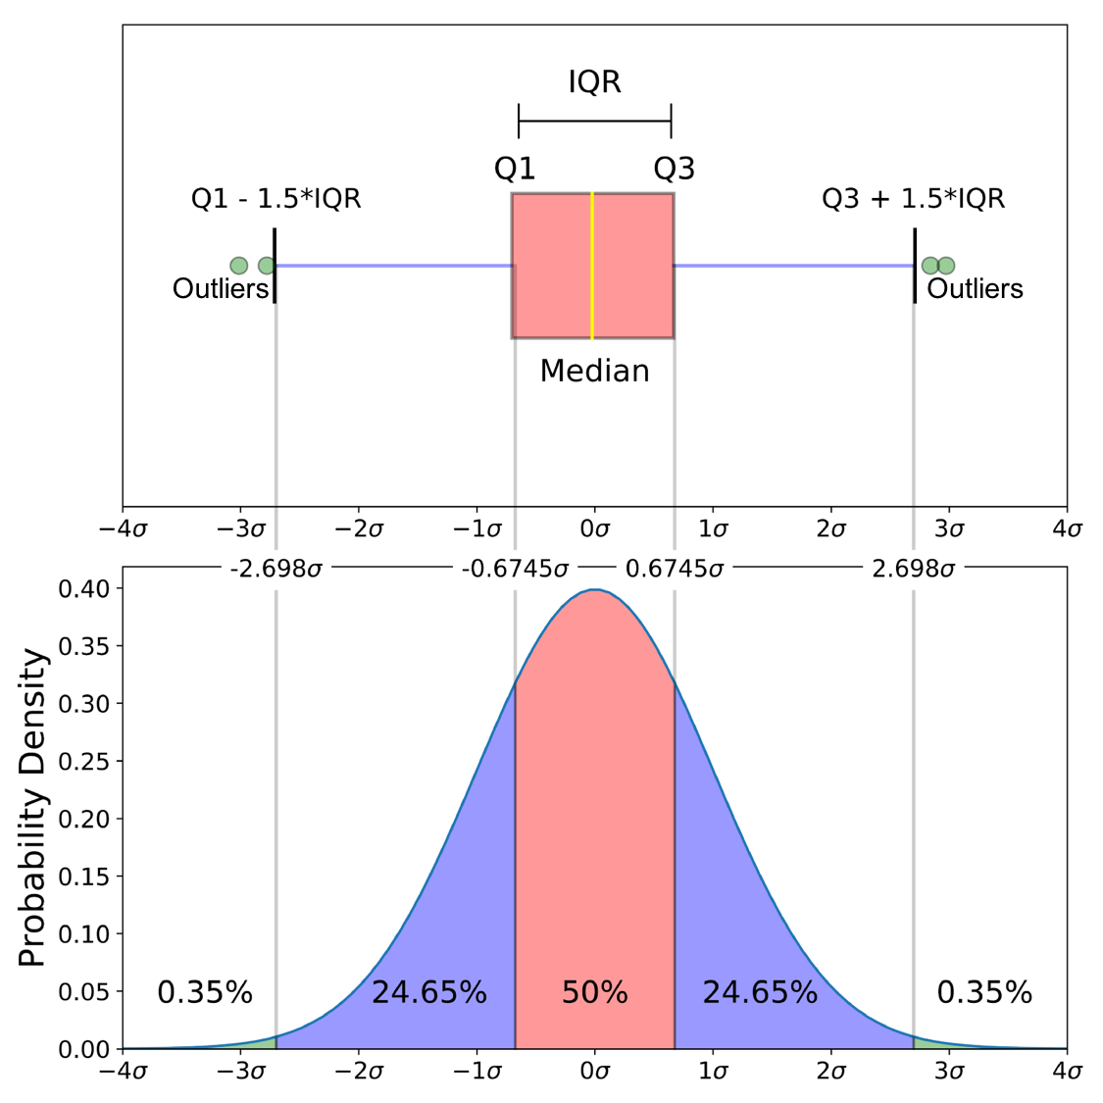
Boxplot

Slide 10
Missing values
Many reasons for missing values
There are multiple ways to deal with the missing values.
Drop the missing value records?
What can we do with what we have?

Slide 11
Multicollinearity
In regression, "multicollinearity" refers to predictors that are correlated with other predictors.
Problems caused by multicollinearity
make the estimates very sensitive to minor changes in the model.
independent variables should be independent.
Unstable model
Dealing with the problem
Remove some of the highly correlated independent variables.
Linearly combine the independent variables, such as adding them together.
Some more techniques.

Slide 12
Near Zero Variance
Constant features
Why we are removing these?

Slide 13


Scaling
Min max scaling - scales and translates each feature such that it is in the given range on the training set, e.g. between zero and one.
Standard scaling - scales data such that its distribution will have a mean value 0 and standard deviation of 1.

Slide 14
Transform
Most Frequently log transform
to achieve linearity.
to achieve homogeneity of variance.
First, transform the dependent variable. Then if required transform the X variable to achieve linearity.
Sometime other transforms (roots, powers etc)
Remember to interpret the model.
Notes:
Ref : https://newonlinecourses.science.psu.edu/stat501/node/319/

Slide 15
Polynomial Regression
special case of linear regression
A curved or non linear line might be a better fit.
Polynomial regression is useful as it allows us to fit a model to nonlinear relation.

Slide 16
Building Polynomial Features
Polynomial Features
Interaction Terms : a *b
Notes:
Ref : https://scikit-learn.org/stable/modules/generated/sklearn.preprocessing.PolynomialFeatures.html

Slide 17
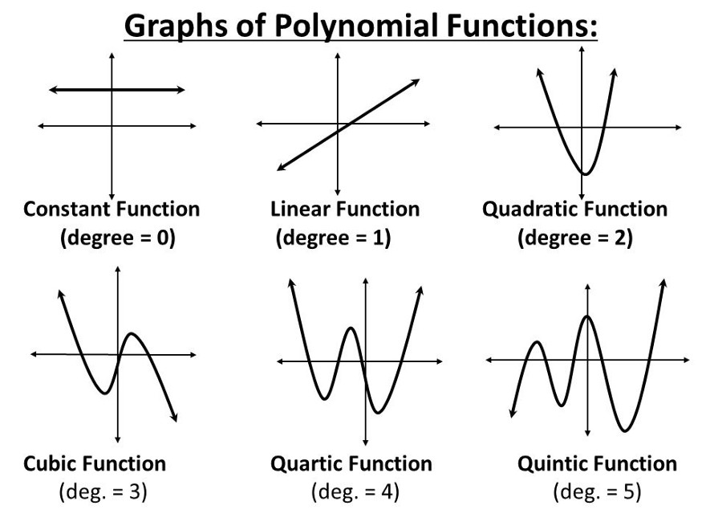
Polynomial Functions
Notes:
Ref : https://towardsdatascience.com/overfitting-vs-underfitting-a-complete-example-d05dd7e19765

Slide 18
“By failing to prepare, you are preparing to fail.”
Benjamin Franklin

Slide 19
Thanks!

